Slide 1
MBC 2023 Annual Conference: Hot Topics in Lactation
October 12 - 13, 2023
CentraCare Campus, St Cloud, MN

Slide 2
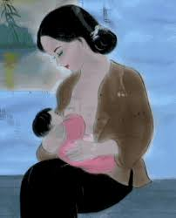
WELCOME!
Returning Attendees
First Time Attendees
MBC Members
Speakers
Sponsors
Notes:
Ask who is here- Clinics, public health/WIC, hospitals, other
Docs, nurses, LCs, doulas, nutritionists, PA, NP, other....

Slide 3
Land Acknowledgement
Every community owes its existence and vitality to generations from around the world who contributed their hopes, dreams, and energy to making the history that led to this moment. Some were brought here against their will, some were drawn to leave their distant homes in hope of a better life, and some have lived on this land for more generations than can be counted. Truth and acknowledgment are critical to building mutual respect and connection across all barriers of heritage and difference.
We begin this effort to acknowledge what has been buried by honoring the truth. We are standing on the ancestral lands of the Dakota people. We want to acknowledge the Dakota, the Ojibwe, the Ho Chunk, and the other nations of people who also called this place home. We pay respects to their elders past and present. Please take a moment to consider the treaties made by the Tribal nations that entitle non-Native people to live and work on traditional Native lands. Consider the many legacies of violence, displacement, migration, and settlement that bring us together here today. Please join us in uncovering such truths at any and all public events.*
*This is the acknowledgment given in the USDAC Honor Native Land Guide – edited to reflect this space by Shannon Geshick, MTAG, Executive Director Minnesota Indian Affairs Council

Slide 4
Housekeeping
Restrooms
Lactation Space
Meals
Bistro
custom-made drinks
Thursday: Alfredo pasta
Friday: Sub Sandwiches, Pickle Pizza and soup
Notes:
Bathrooms are located on all levels of the Plaza, just down the hall to the left as you leave the Windfeldt room, and straight back down the long hallway from the Windfeldt room
custom made drinks.
-Thursday: Alfredo Pasta. Choice of Chicken or Shrimp and Broccoli. Served with a breadstick
-Friday: Sub Sandwiches, Pickle Pizza and Soup.

Slide 5
Agenda
Silent Auction (Thursday)
Bidding closes at 3:10
Pick up at end of day (4 p.m.)
Pay by cash, check, credit card
Lactation Trivia Night Thursday 6:30 – 8:30
Door prizes – end of day Friday (1:30 p.m.)

Slide 6
Become a member of the MBC Expanded Categories
Individual
Persons who attend workshops, help plan events, participate in special projects, contribute to MBC subcommittees or teams, hold a leadership role, or simply contribute financially to the future of MBC
Nonprofit
Organizations that have the 501c3 or other similar status and are committed to MBC's mission and purpose. MBC cannot accept financial support from organizations connected to the formula industry
Business
Businesses in which owners/shareholders receive profits or organizations in the public sector. These businesses should be committed to MBC's mission and purpose and not connected to the formula industry
Notes:
Helping keep MBC sustainable

Slide 7
Wrap up
Evaluations (online link will be emailed)
CERP certificates and nursing contact hours
2023 Annual Meeting October 19
7 – 8 p.m. (virtual)
Don’t forget the MBC on-demand webinars
mbc41.wildapricot.org
Notes:
At the end of the workshop there will be a drawing for some neat prizes…during which you’ll fill out your evaluations and then get your CEU certificate at the registration table on the way our after you hand in your evaluation. For CERPS ( and RD credits)- need to put your email down and we will send certificate

Slide 8
THANK YOU!
To our generous sponsors for helping to make this meeting a success!
Platinum Gold Bronze

Slide 9
THANK YOU!
To our exhibitors for helping to make this meeting a success!
Make sure to visit their tables

Slide 10
Thank you!
MBC Event Planning Committee
Our event volunteers
All the speakers

Slide 11
Minnesota’s Landscape
How are Minnesota families doing?
What’s happening around Minnesota in breastfeeding and chestfeeding promotion and support?
How can you be involved?

Slide 12
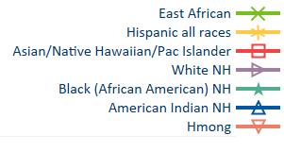
How are Minnesota families doing?
Breastfeeding initiation in Minnesota 2012 - 2022
Source: MN Vital Records

Slide 13
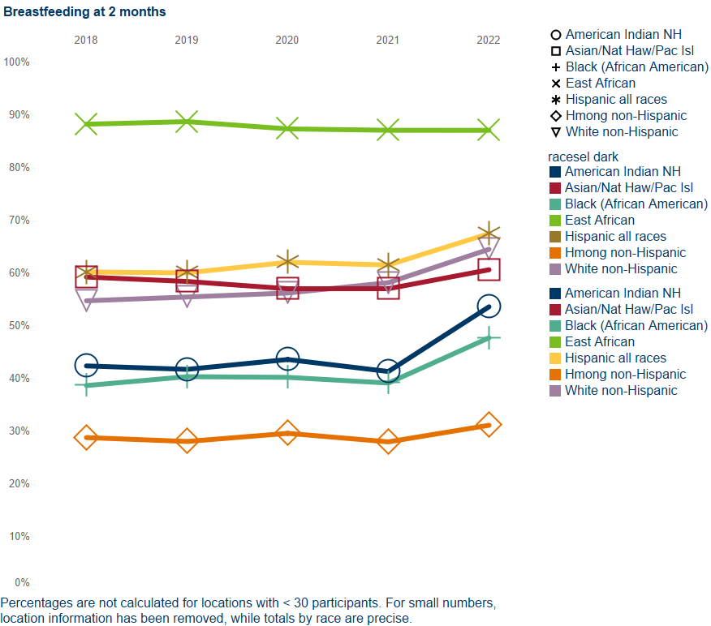
How are Minnesota families doing?
Breastfeeding at 2 months of age in Minnesota WIC
Source: WIC Information System

Slide 14
What’s happening around Minnesota?
Minnesota Breastfeeding Coalition
mnbreastfeedingcoalition.org
Ten Step Learning Collaborative
Recent one-time funding
Perinatal experiences study
13 Minigrants to birthing facilities
Zipmilk
Notes:
Minigrants: provider education, RN education, IBCLC education, employee lactation support, (nursing chair, refrigerator), postpartum support group, start an antenatal hand expression program

Slide 15
What’s happening around Minnesota?
Minnesota Breastfeeding Coalition
NextGen
Education events
Local coalitions

Slide 16
What’s happening around Minnesota?
MDH WIC Program
Promoting Equity in Lactation grants
WIC Lactation Continuing Education
Designated Breastfeeding Experts (DBEs)
MDH Breastfeeding-Friendly Recognition Programs www.health.state.mn.us/people/breastfeeding/recognition/index.html
SHIP: Statewide Health Improvement Partnership
Department of Labor and Industry www.dli.mn.gov/newparents
Notes:
A

Slide 17
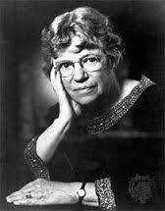
How can you be involved?
“Never doubt that a small group
of thoughtful, committed citizens
can change the world.
Indeed, it is the only thing
that ever has.” – Margaret Mead

