Slide 1
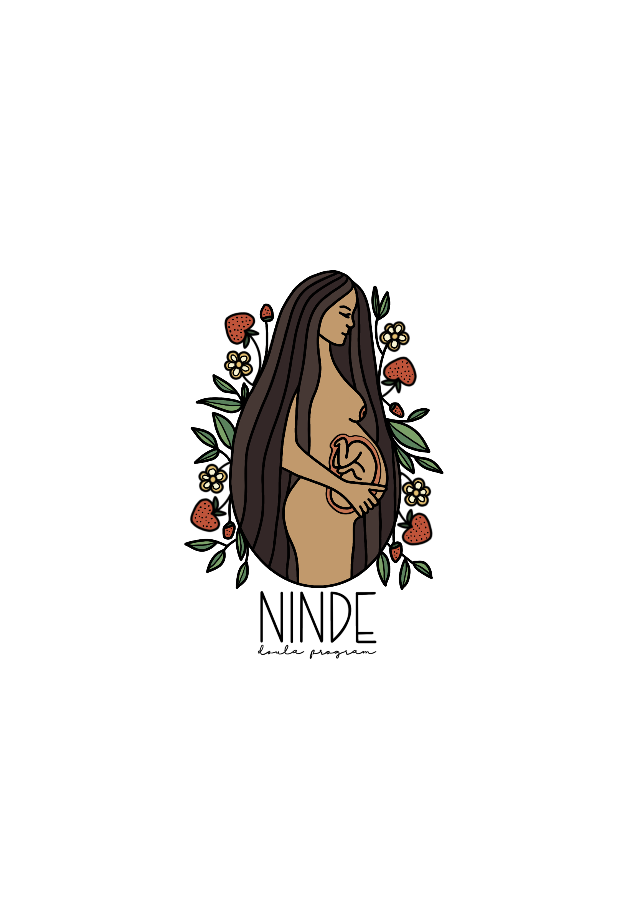
NINDE DOULA PROGRAM
Division of Indian work

Slide 2
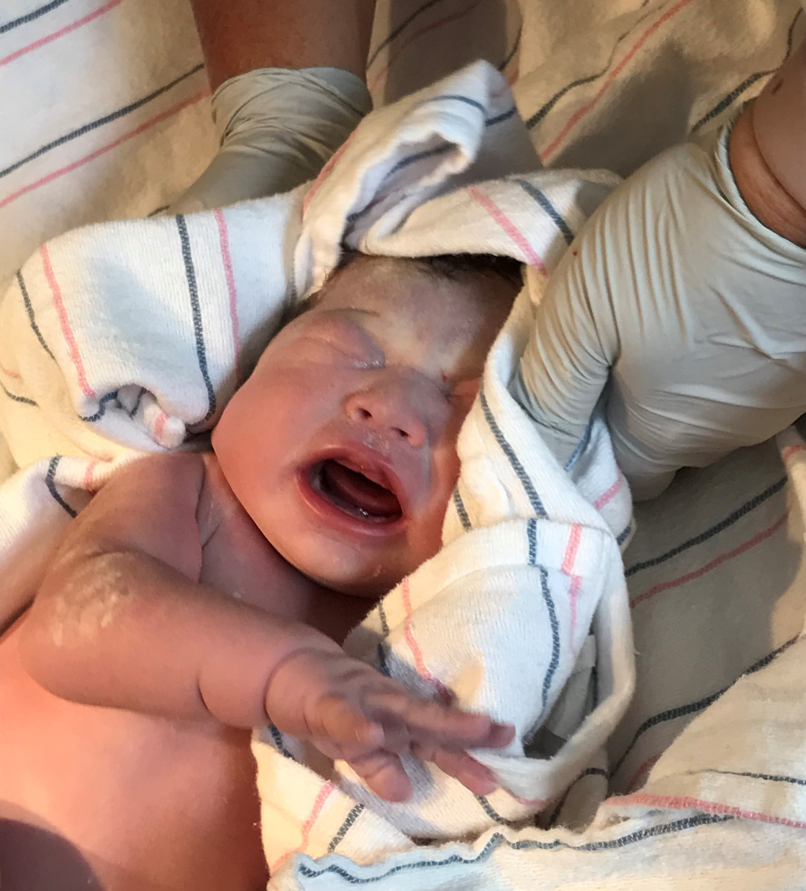
Maternal and Child Health Disparities in Indian Country
American Indian/Alaska Native women and communities experience multiple disparities compared to the general population, which extends into disparities related to maternal and child health. Nationwide, American Indian/Alaska Native women are two and a half times as likely as white women to die during pregnancy, delivery, or during the first year after giving birth.

Slide 3
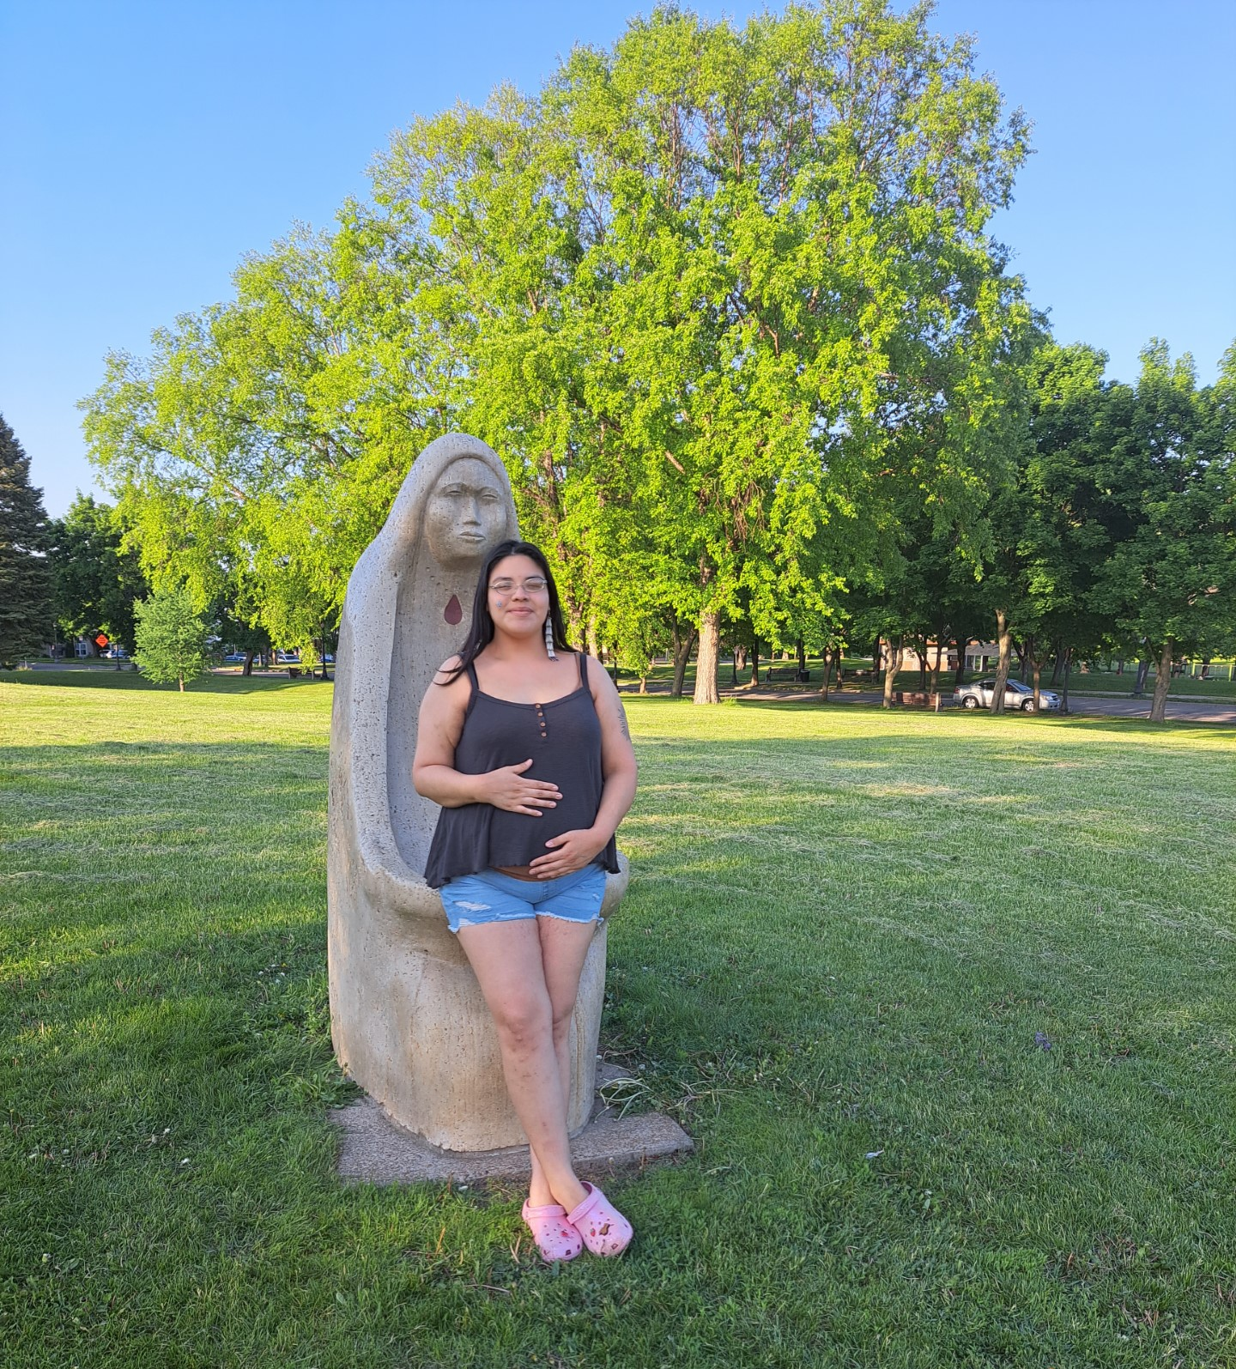
Pregnant Indigenous Women
In Minnesota, American Indian/Alaska Native women of reproductive age (age 15-44) died at a rate about two-and-a-half times higher than white women (191.2 and 78.0 per 100,000, respectively). In 2018, the American Indian/Alaska Native infant mortality rate was 10.44 per 1,000 live births, compared to 3.97 for white and 8.77 for African American infants.2 In addition, social determinants of health, such as poverty and lack of prenatal care, disproportionately affect American Indian/Alaska Native women and families.

Slide 4
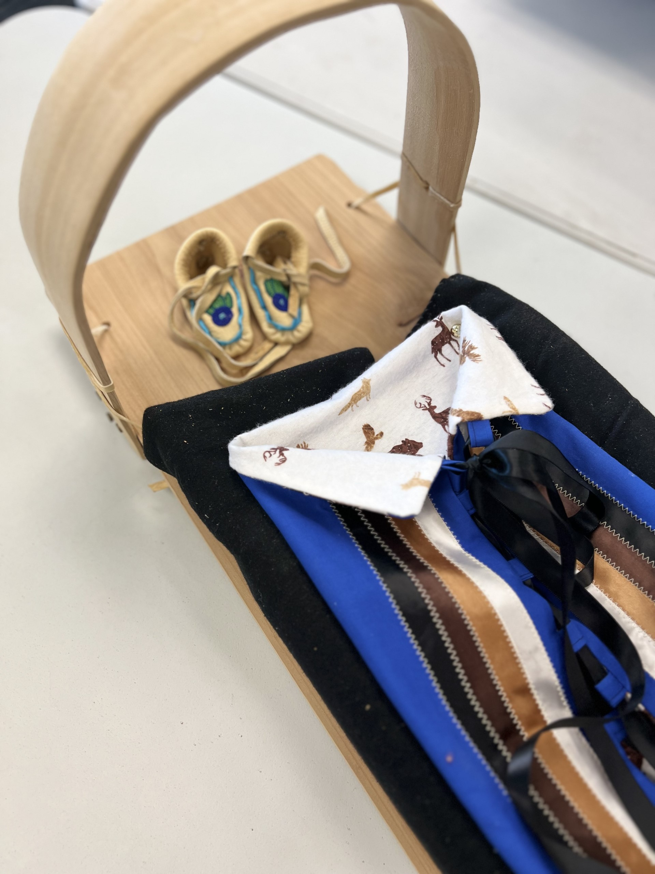
History of Ninde
Ninde began in 2015. Health professionals working with the American Indian community noted an increase in infants diagnosed with Neonatal Abstinence Syndrome. The Maternal and Child Health (MCH) Coordinators at the City of Minneapolis organized a group of MCH professionals to discuss the issue and brainstorm what kind of response could be mounted without grant funding. The Division of Indian Work (DIW) served as the fiscal agent for the project, which DIW’s Executive Director managed. An extremely limited evaluation of the Ninde doula project took place. A collaborative was formed to improve perinatal American Indian health and met monthly.

Slide 5
Ninde Collaborative​
Ninde Collaborative formed out of concern about the opioid epidemic’s effect on maternal and child health in the Twin Cities Native community​
Includes health professionals, staff from community-based agencies, and community members ​
Ninde means ​
“my heart”—​
a term of endearment Ojibwe mothers use for their babies​
​

Slide 6
What is a doula?
A doula is a trained person who provides emotional, physical, and spiritual support for people while they are pregnant, during the birth, and after the baby is born, much like how family members traditionally helped bring new life into this world.
Doulas are not health care providers—they are a support person focused on a birthing person’s overall wellbeing. When a person has a doula, they are more likely to have a positive birthing experience, they are less likely to need a C-section, and are less likely to need pain medicine. Birthing persons with doulas also tend to have shorter labors.

Slide 7
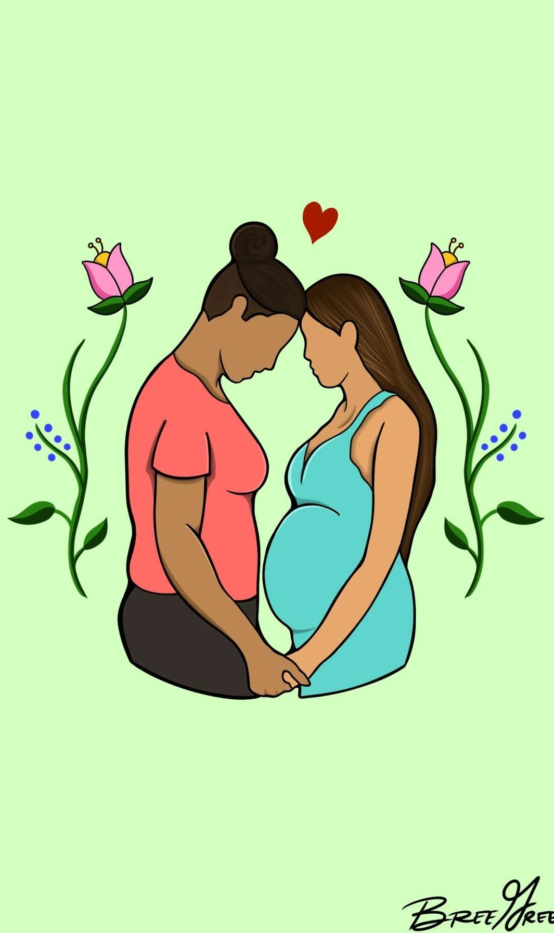
What our Ninde doulas do…
Ninde doulas provide typical, Western doula services ​
Doulas are non-clinical caregivers who provide physical, emotional, and informational support to pregnant people and their partners, before, during, and after childbirth
Ninde doulas also provide culturally-specific support​
Singing​
Smudging​
Placenta keeping​
Use of traditional medicines​
Family/partner education and support

Slide 8
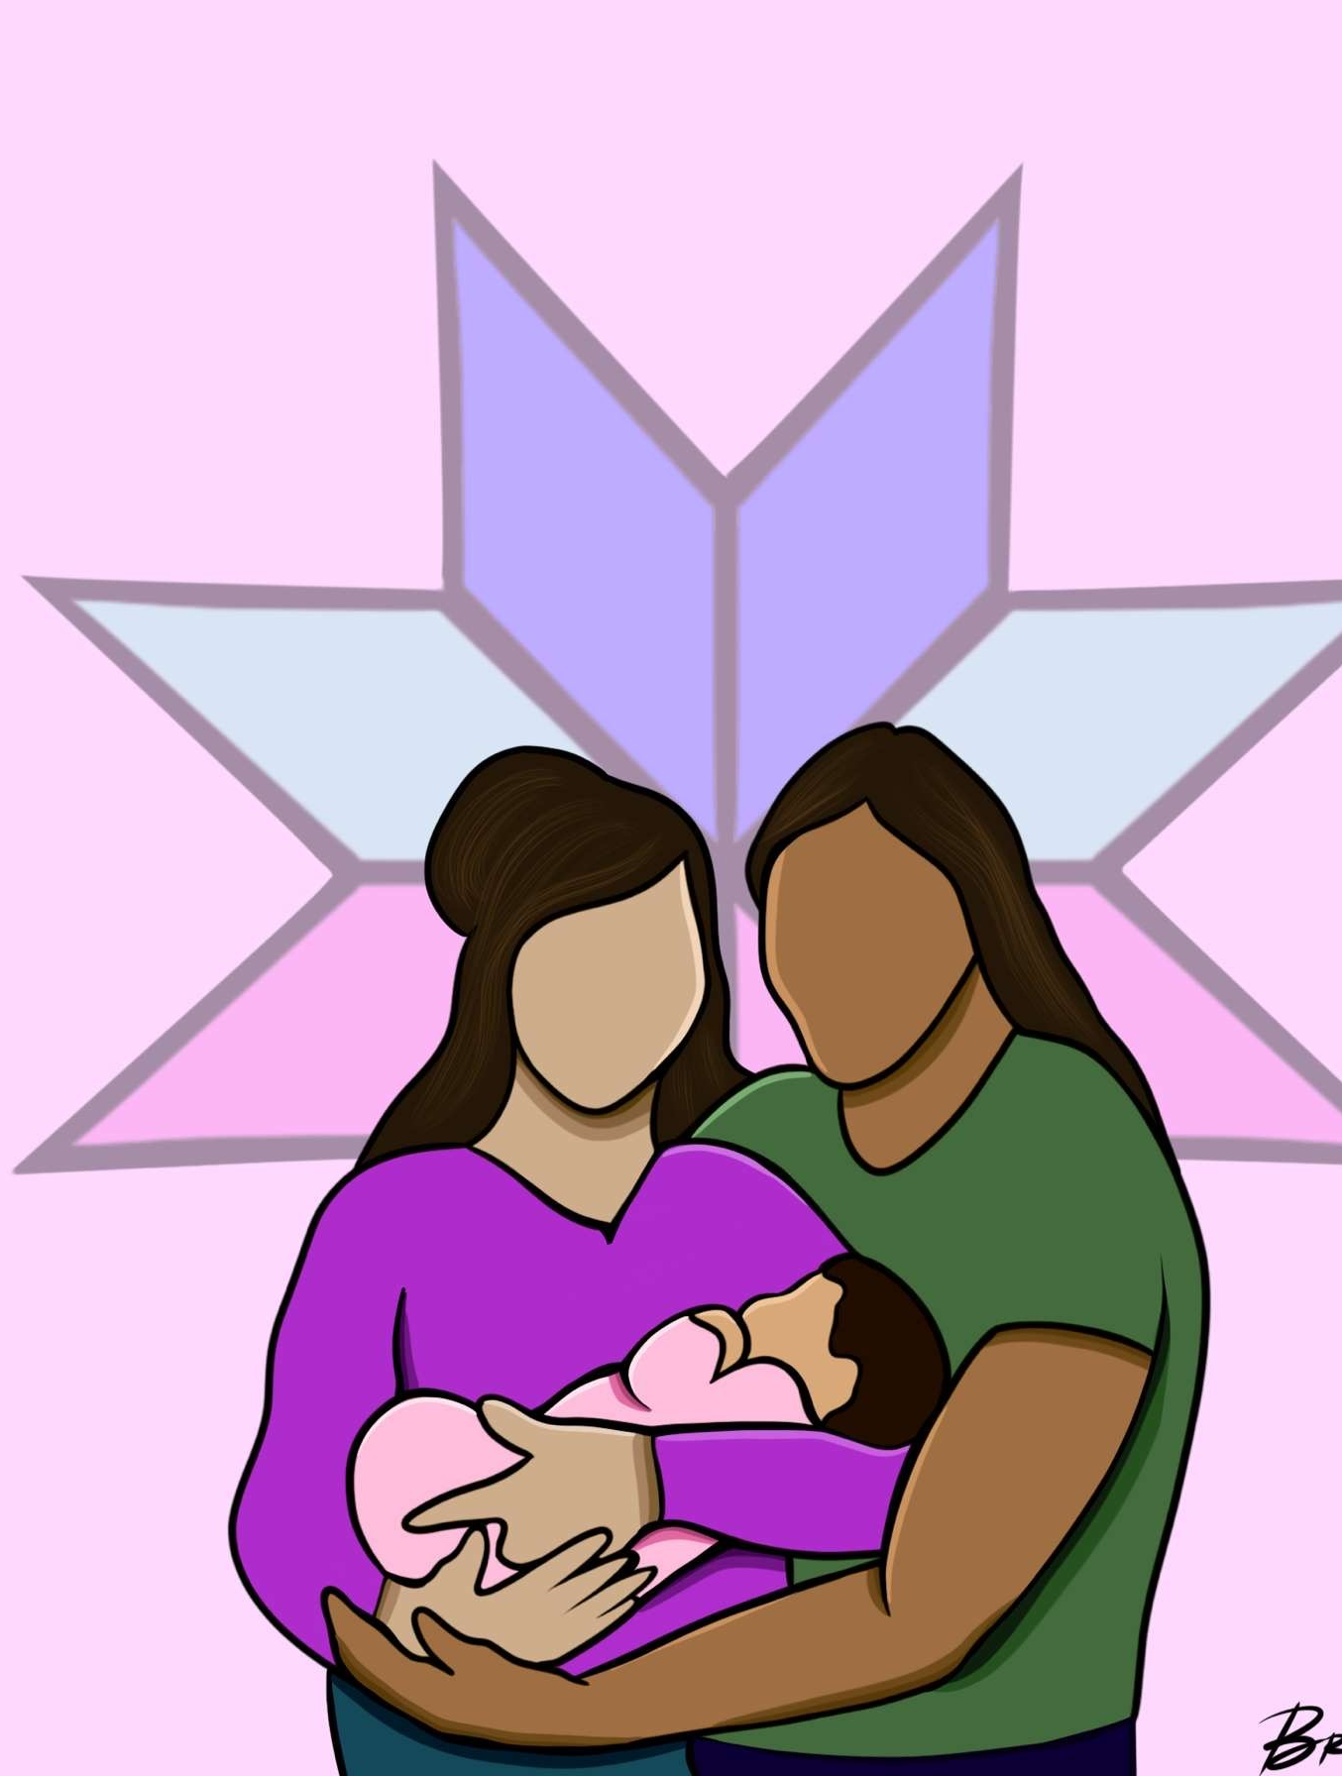
Comprehensive doula training
COPE Training-Community Outreach Perinatal Educator
The COPE program uses a culturally sensitive and trauma-informed curriculum that includes comprehensive training for community-based Doula, Childbirth Education and Breastfeeding Education for peer-supporters, community health workers, para- professionals and home visitors.
Zaagi’idiwin training
Full spectrum indigenous doula training, indigenous midwifery workshops, breastfeeding education health.

Slide 9
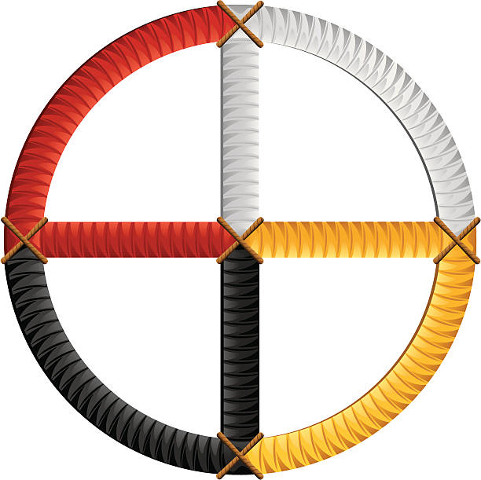
Type of support Ninde doulas provide
Mental (Intellectual)​
Increasing their knowledge on their rights and options​
Preparing moms to ask questions if they don’t know what something is ​
Sharing breastfeeding knowledge​
Education about fitness and nutrition​
Informing about things in community (events, resources)​
Talking about important things to teach a child (values )​
Making sure they know how to connect with baby—singing, nursing, talk to baby, holding baby. ​
Talking about birth to help overcome fear and anxiety​
Teaching about traditional practices
Spiritual​
Helping them realize they are sacred beings​
Smudging​
Giving mom a tobacco pouch to put out​
Giving cedar and sage to put in a pouch by the crib to help with the baby’s crying​
Connecting to elders/community members for ceremonies for placenta and umbilical cord​
Honoring a space for god or gods to help moms be comfortable with what they believe… honoring spirituality can motivate her through the that strength that God gives her​
Harvesting sage and cedar together​
Teaching about ceremonies (e.g., water and full moon ceremonies)​
Emotional​
Listening to what they have to say and responding with love and support and listening​
Talking to moms about whatever is going on with her at this sacred time in her life​
Holding open conversations about trauma, helping them understand their emotions so they can create a new path​
Watching for red flags for postpartum depression​
Letting them know the doula is here for them—they are not alone​
Praising moms: “look how good you’re doing!” “Look how she responds to you!”​
Physical​
Supporting during labor and delivery (massage, holding hands, suggesting birth positions, etc.)​
Providing referrals for counseling, baby items, WIC, childcare, etc.​
Helping getting into treatment or staying sober​
Being there and meeting in person ​
Providing sage and cedar for labor and delivery​
Supplying essential oils​
Helping women stay on track with chronic conditions​
Providing supplies (pack-n-plays, car seats, etc.)​
​

Slide 10
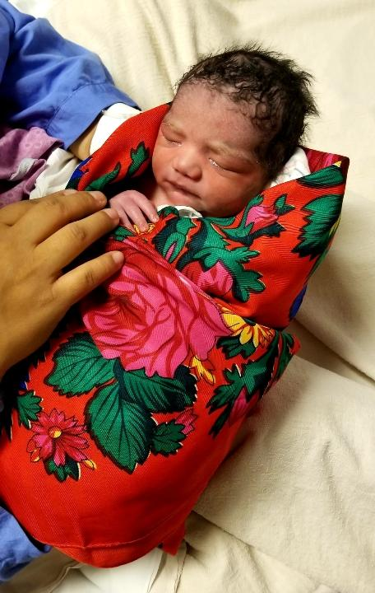
Doulas provide long term support
Work with pregnant women and new moms​
During pregnancy (at least 3 visits)​
At the birth​
Provide various information to moms for child rearing and cultural teaching
After the pair return home (at least 2 visits)​
Make referrals to others at end of time working together​
Provide lactation support

Slide 11
Lactation Support
Nitamising Gimashkikinaan provide collaboration and supportive environments when the Ninde Program clients require other assistance. Together both programs bring a well-rounded program concept to the clients they serve.
MN Milk Bank for Babies, if mothers are having trouble producing milk, DIW is a milk bank recipient and can provide supplemental milk for babies who need breast milk.

Slide 12
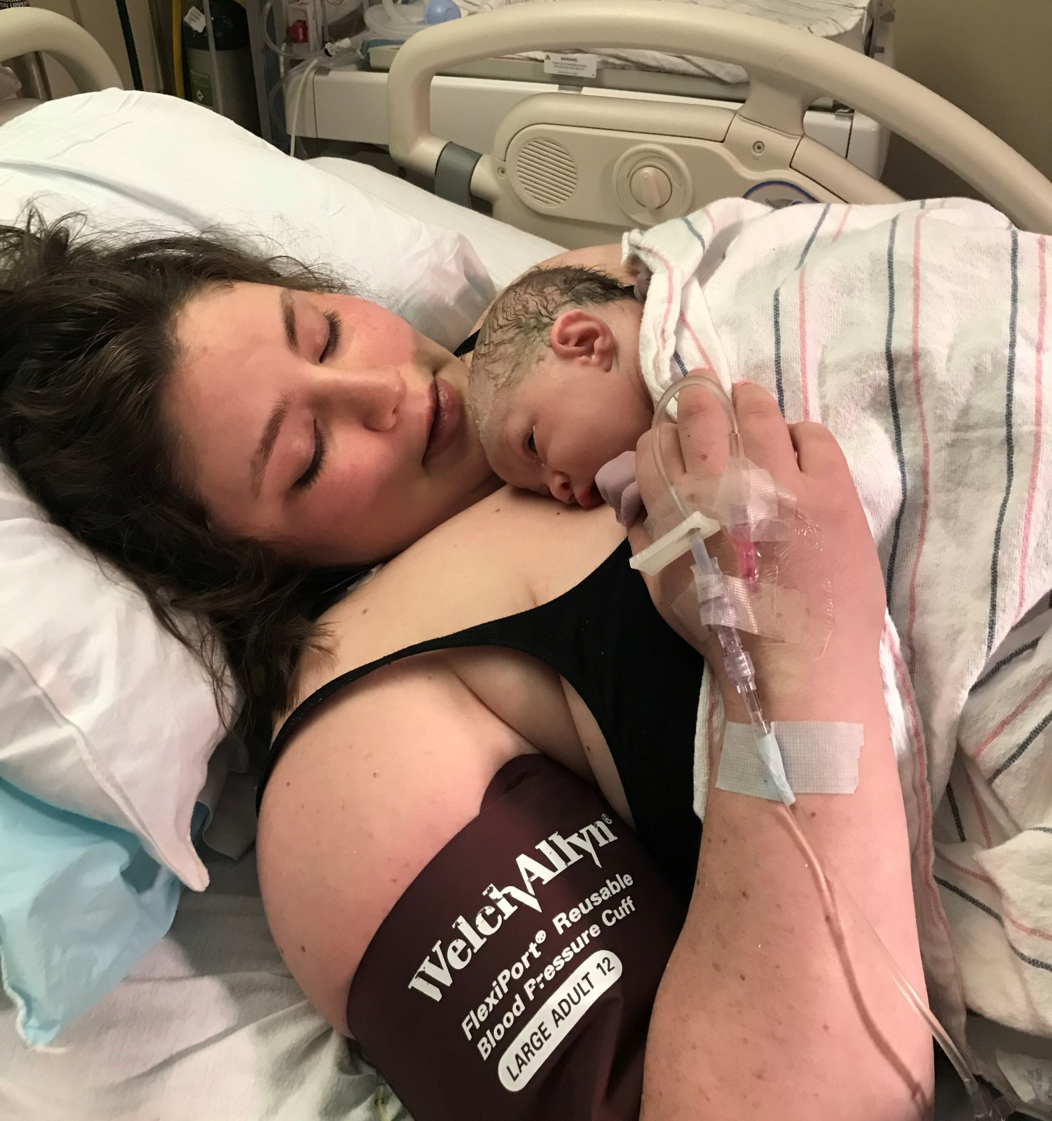
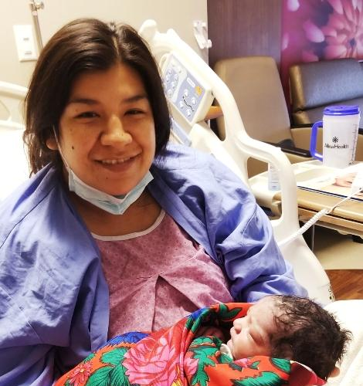
Ninde mothers and babies

Slide 13
Traditional Medicine

Slide 14
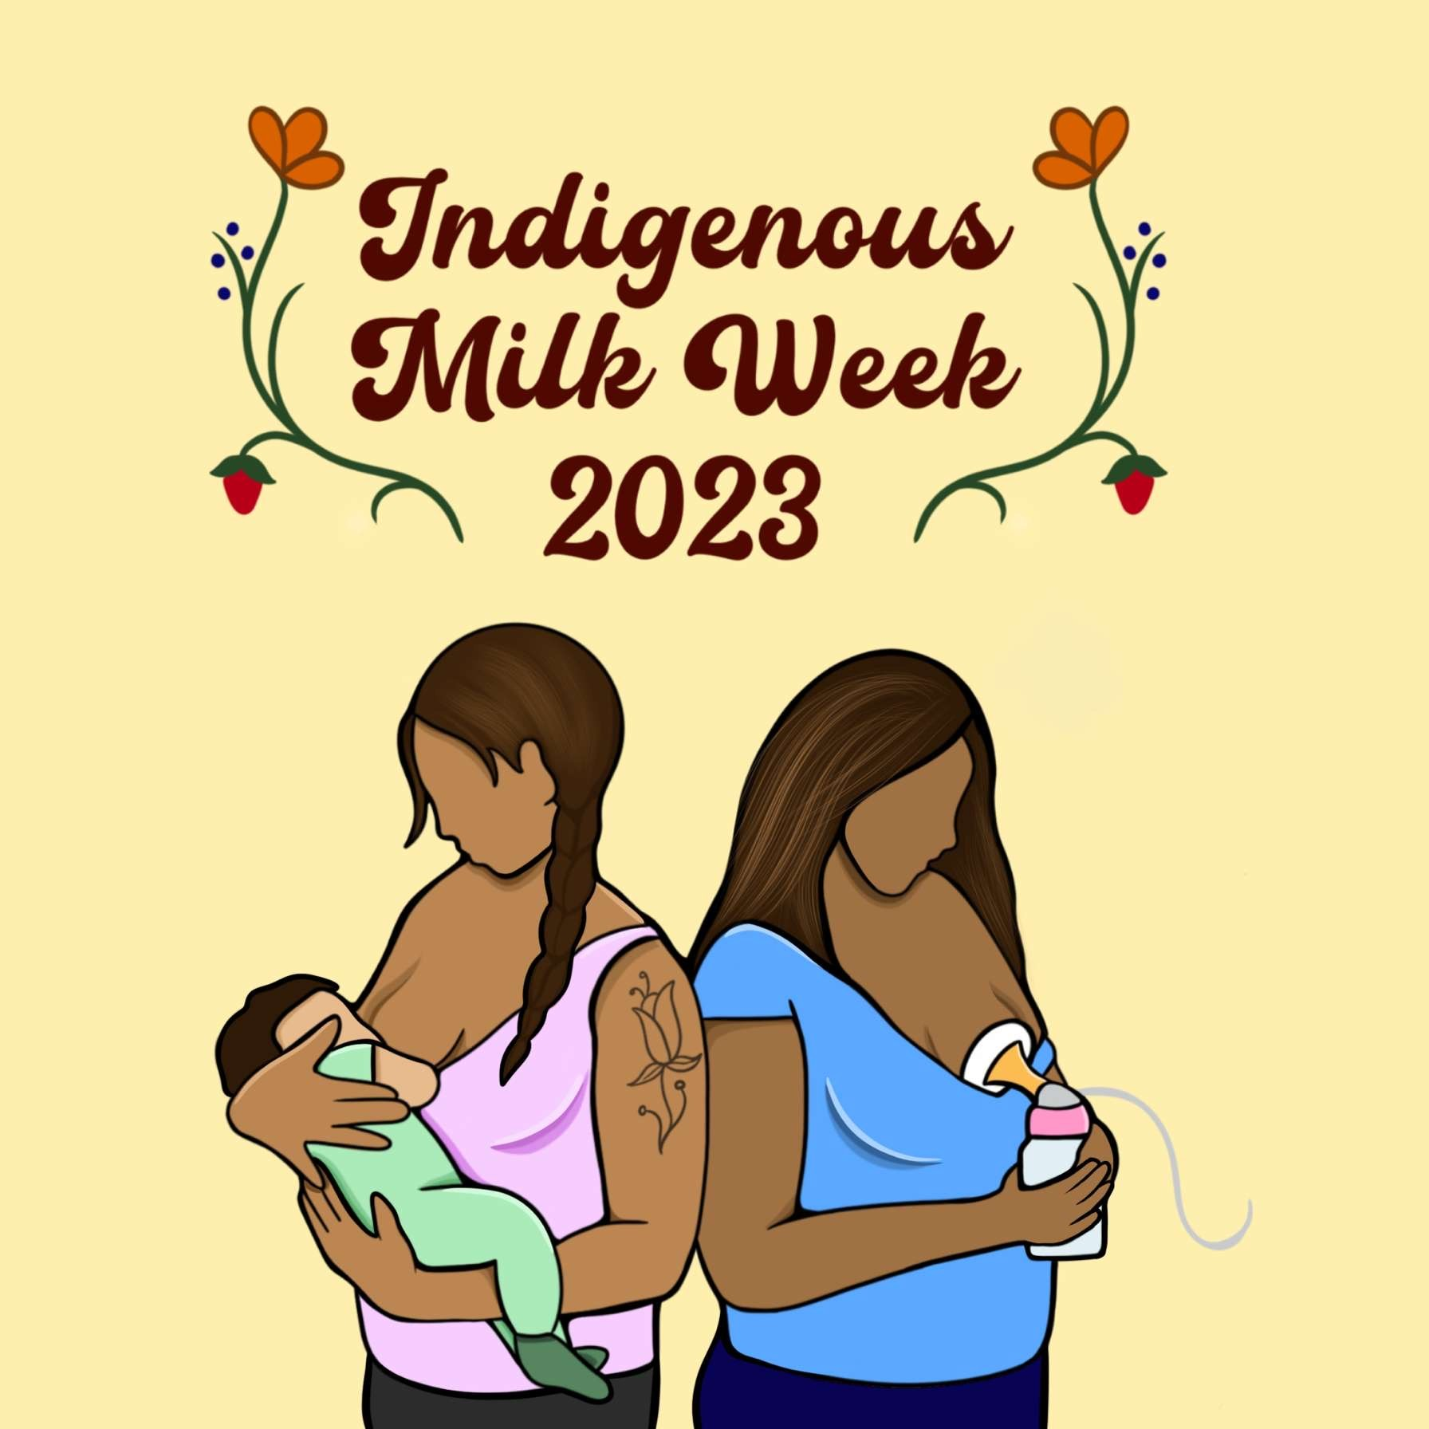
Lactation Support
Breastfeeding training for doulas
Lactation support and breastfeeding instructions were consistently provided for mothers
If mothers decided not to breastfeed, WIC services were introduced.
Mobile lactation station
Events at DIW for Indigenous Milk Week

Slide 15
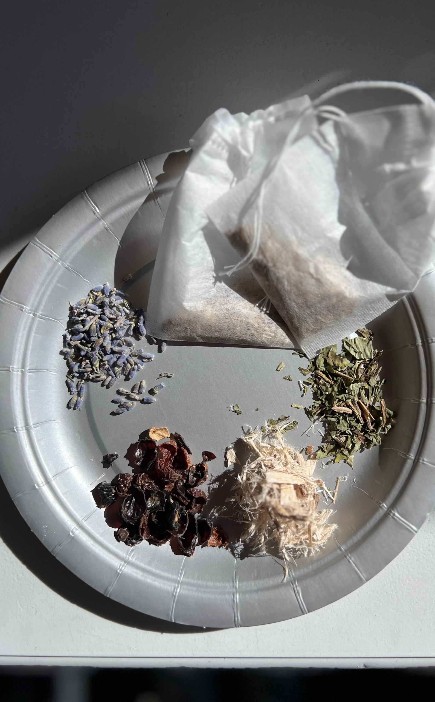
Cultural Healing
Talking & singing soothing prayers
Giishik (cedar) baths
Smudging
Body massages
Shkodewabik (sage), Wingashkoon (sweet grass), and Naabagondaak (cedar) cleansings
Placental ceremonies according to the tribal protocols represented
Asemaa (tobacco) offerings
Supportive services through visitations with the doulas as mentors

Slide 16
Citations
Petersen EE, Davis NL, Goodman D, et al. Vital Signs: Pregnancy-Related Deaths, United States, 2011-2015, and Strategies for Prevention, 13 States, 2013-2017. MMWR Morbidity and mortality weekly report. 2019;68(18):423-429.
Minnesota Department of Health. 2018 MN Health Statistics Annual Summary In: Minnesota Center for Health Statistics, ed. St Paul, MN2019.
Great Lakes Inter-Tribal Epidemiology Center. American Indian and Alaska Native Health in Michigan, Minnesota, and Wisconsin 2016. Lac du Flambeau, WI: Great Lakes Inter-Tribal Epidemiology Center, Great Lakes Inter-Tribal Council, Inc.;2016.
Continuous Support for Women During Childbirth: 2017 Cochrane Review Update Key Takeaways. The Journal of perinatal education. 2018;27(4):193-197.
Hardeman RR, Kozhimannil KB. Motivations for Entering the Doula Profession: Perspectives From Women of Color. Journal of Midwifery & Women’s Health. 2016;61(6):773-780.doi:10.1111/jmwh.12497
Kozhimannil KB, Vogelsang CA, Hardeman RR, Prasad S. Disrupting the Pathways of Social Determinants of Health: Doula Support during Pregnancy and Childbirth. Journal of the American Board of Family Medicine. 2016;29(3):308-317. doi:10.3122/jabfm.2016.03.150300
Villebrun, S., & Porter, M. (2020). My Heart: A Culturally Specific Program for Urban Indigenous and Latina Women.

