Slide 1
Promoting Population Health with the use of Human Milk
Presented by:
Jeanne Friebe BSN RN IBCLC RNC-LRN

Slide 2
Learning objectives
the value of prenatal hand expression/colostrum harvesting and why some mothers chose not to
how to teach prenatal hand expression/colostrum harvesting
how to get parents, providers and your organization on board with colostrum harvesting and the use of pasteurized donor human milk

Slide 3
Terminology
Removing milk from the breast during pregnancy has interchangeable names/titles
Prenatal Hand Expression
Antenatal milk expression (AME)
Colostrum Harvesting
This Photo by Unknown Author is licensed under CC BY-NC-ND

Slide 4
Poll Questions
Are you teaching prenatal hand expression and helping patients harvest their colostrum prenatally?
In what region of MN are you working with your patients

Slide 5
My Journey
Getting things started in Central MN

Slide 6
Getting Folks on Board
Patient
Providers
Childbirth Educators
WIC
Public Health
Community

Slide 7
Finding some evidence
In a randomized controlled trial published in Oct. 2019
Women perceived multiple benefits of AME (antenatal milk expression), most notably that it increased their confidence that they would be able to make milk and breastfeed successfully postpartum.
Women expressed some concern that no/little milk expressed could be indicative of postpartum milk production problems. Regarding implementation, women found that the AME protocol fit well into their daily routine.
There was mixed feedback regarding comfort with practicing AME in the presence of partners.
Reasons for postpartum use of AME milk varied; barriers to provision included inadequate milk storage options at the birth hospital and unsupportive hospital providers/staff.
"It gave me so much confidence": First-time U.S. mothers' experiences with antenatal milk expression Maternal Child Nutr. 2019 Oct;15(4):e12824. doi: 10.1111/mcn.12824. Epub 2019 May 23.

Slide 8
To harvest or not ???
I start this discussion at 28-week prenatal visit if possible
Educate to help make decision, utilize handout
Discussion with provider
Benefits:
to have colostrum for managing infant hypoglycemia
avoid use of formula for supplementing
avoid early weaning ( 2-3-fold-risk of early breastfeeding cessation assoc. with formula supplementation in hospital)
Teaches mother to learn how to do hand expression
Concerns:
That it will cause PTL (preterm labor)
Can lead to doubt in mothers’ ability if she does not get any colostrum when trying to harvest
No established evidence to support that this leads to onset of Lactogenesis 2 (milk coming in)

Slide 9
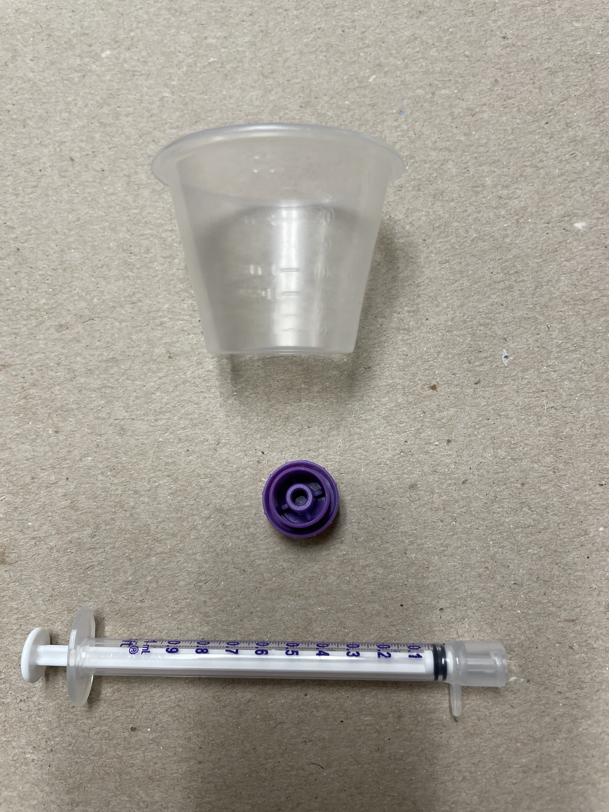
Supplies to accomplish this
Costs: 1-2 ml sized syringe/caps, 0.13 cents,
Ziploc Bags, .06 each,
Med cups 0.56/100

Slide 10
Prenatal Hand Expression: Patient education handout
What is prenatal hand expression?
Hand expression means you are using your hands to compress your breasts in a way that colostrum comes out. Hand expressing before your baby is born is called prenatal hand expression. For many mothers, this can be done safely in the final few weeks of pregnancy.
Discussion with your healthcare provider
You should not attempt this without first discussing it with your prenatal care provider. It may not be recommended if you are at risk of preterm labor or have certain other risk factors such as placenta previa. It is advised for mothers to wait until 37 weeks before starting to express colostrum.
Why should I consider prenatal hand expression?
If your baby is experiencing difficulties with breastfeeding or needs to be supplemented for medical reasons, you may be asked to express some fresh colostrum to give to your baby. You may be able to use the colostrum you have expressed prenatally. This can help limit the need for formula.
There are reasons why women may need to consider supplementing their baby’s feeds.
They include women who have risk factors such as:
Breast hypoplasia (limited breast development)
Previous breast surgeries
Obesity
Diabetes
High blood pressure
History of PCOS (poly-cystic ovarian syndrome)
Have a history of low milk supply
Have certain endocrine disorders
Colostrum helps your baby stay healthy. It helps to colonize your baby’s gut with healthy bacteria that protect against allergies and disease. It contains the perfect balance of proteins, fats, and micronutrients needed for human babies. Colostrum can also help baby pass the first meconium stools, which can be very sticky.

Slide 11
Prenatal Hand Expression: Patient education handout
How to hand express your colostrum
It is better to express your colostrum by hand than to use an electric or manual breast pump. Colostrum will be produced in very small quantities. It can stick to the bottles or pump parts and be hard to collect.
Always wash your hands before expressing it.
Applying a warm compress to your breast or expressing after a warm bath or shower can help the flow of colostrum.
Get yourself comfortable. Try sitting and leaning slightly forward.
Start with a gentle breast massage, stroking from the back of your breast towards the nipple to encourage the let-down reflex.
Put your thumb above the nipple and your first few fingers below the nipple. You will be cupping the breast in a ‘C’ shape.
Move your thumb and fingers a few centimeters back from the nipple
Press in towards your chest, press your fingers together, and draw them forwards.

Slide 12
Prenatal Hand Expression: Patient education handout
Repeat this process, building up a rhythm.
Colostrum should start to arrive drop by drop. (Initially, it may just be a glisten on the end of your nipple, and it may take a few days of practice before drops appear)
Colostrum can vary in appearance. Sometimes it may appear thick and yellow and at other times pale white and thin.
Collect the colostrum into a clean container, like a syringe (1ml or 2ml syringe).
If nothing happens, adjust your finger position slightly to find the spot that works for you. You should not be pinching the nipple or sliding the fingers uncomfortably over the skin.
Rotate the position of your fingers and thumb around the areola (imagine a clock face) and repeat the expressing process to stimulate and remove colostrum from different parts of your breast.
Express each breast twice during each session.

Slide 13
Prenatal Hand Expression: Patient education handout
Storage of human breast milk
For complete colostrum and breastmilk storage guidelines, refer to the handout “Human Milk Guidelines for the Healthy, Term Infant”.
You must label your colostrum.
You must use the labels provided by your clinic. These labels will have your name, birth date, and medical record number printed on them. This is important because it will be part of the safety check process in the hospital.
Make sure to write the date and time you collected your colostrum on the label, then stick the label onto the syringe.
Colostrum can be collected two or three times each day. Start with doing 5 minutes/breast. May repeat.
Collect the colostrum into a clean container, like a small medicine cup, then draw up using a syringe (1ml or 2ml syringe). If getting large amounts, you can pour the colostrum into a breast milk freezer bag.
You will need to store the syringe in the refrigerator between uses. At the end of the day, the colostrum can be frozen. Place the syringe into a freezer bag before putting it into the freezer.
You can take syringes of frozen colostrum into the hospital using a freezer block and insulated bag. The syringe can be thawed under running warm tap water or in a breast milk warmer. A microwave or boiling water should never be used since hot spots may occur.
Thaw only what a baby will use. Once thawed, it should be used within 24 hours.
It is a good idea to mention your colostrum stores on your birth plan and make sure hospital staff are aware of your wishes.
Prenatal hand expression gives you a back-up if things don’t go according to plan. Many families find this reassuring. You can start your breastfeeding journey knowing how to hand express and have confidence in how your breasts work.
Hand Expression Video Link: https://vimeo.com/65196007

Slide 14
How to do hand expression-Video
https://vimeo.com/65196007
https://bfmedneo.com(/All-Resources/Videos/The-Basics-of-Breast-Massage-and-Hand-Expression-
https://globalhealthmedia.org/videos/how-to-express-breastmilk/
Online video education provides unique advantages for instruction over traditional face to face format
Privacy
Convenience
Play-pause-replay ability
Keep in mind:
Difficult to find a prenatal expression video, most videos are with mothers in lactogenesis 2 already.
O’Sullivan, T;, Cooke, J;, McCafferty, C;, Gigla, R;, Online Video Instruction on Hand Expression of Colostrum in Pregnancy is an Effective Educational Tool: Nutrients. 2019 Apr 19;11(4):883. doi: 10.3390/nu11040883.

Slide 15
Testimonials
Nurses-I recently worked with a handful of breastfeeding mothers who had met/worked with you and came in with several syringes, even some with bags of colostrum. It’s been amazing! You can tell that these moms just feel more relaxed and prepared when it comes to jumping into breastfeeding their babies and keep up on the hand expression. I can’t believe the difference in the amount or EBM these moms have been getting because they started hand expression and learned this from you. I’m not the only nurse who has noticed this and I just wanted to thank you for your work. Mom’s feel good to to have this great gift of EBM for their baby.
Providers- I have noticed in the hospital, when I review instructions for home about breastfeeding and supplementing, the patients mention that they met with lactation prenatally and they are excited and seem more motivated and confident about breast milk feeding.
Parents- I wanted to reach out to you and thank you for teaching me about harvesting colostrum. I brought my four bags worth to the hospital, and everyone was very happy as well as impressed with how much I harvested. I’m so fortunate to have had harvested colostrum. My son had high levels of bilirubin in which we were able to use it all to make sure we knew how much he was taking in on top of breast feeding. We ran out just barely toward the end of our week stay.

Slide 16
The Use of PDHM for supplementation In Hospital
Reasons for Supplementation:
Parent Request- maternal fatigue, not wanting to put baby to breast, not wanting to pump or hand express
Medical - Infant indications Maternal indications
- unable to latch (e.g., Congenital malformation ) -inadequate milk supply
-hyperbilirubinemia -primary insufficient glandular tissue
-Weight loss>75% (NEWT) -breast surgery
-Poor milk transfer -contraindicated medication/illness
-Prematurity -separation of mother/infant with no EBM available
-IUGR/SGA -intolerable pain with breastfeeding
Mary K. Heid Prenatal Hand Expression of Breast Milk to Reduce Formula Use Postnatally A Capstone Report Submitted in partial fulfillment of the requirements for the degree of Master of Science in Dietetics Practice University of Washington 2019 Capstone Faculty Advisor: Michelle Averill, PhD, RD Nutritional Sciences Program School of Public Health

Slide 17
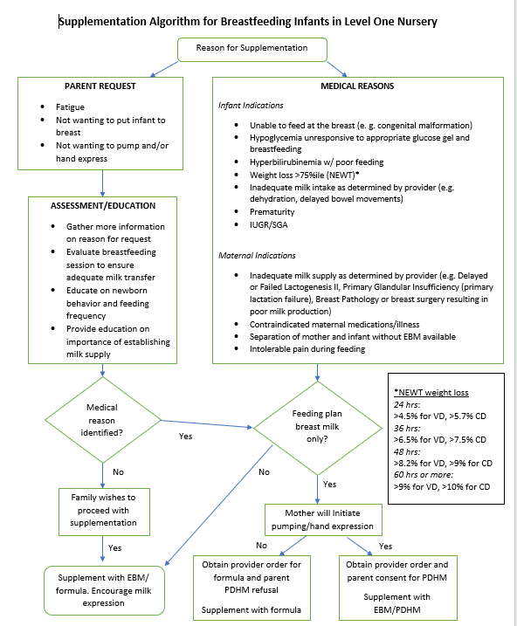

Slide 18
References
Donor Human Milk for the High-Risk Infant: Preparation, Safety, and Usage Options in the United States Pediatrics. 2017 Jan;139(1):e20163440. doi: 10.1542/peds.2016-3440.
Evaluating antenatal breastmilk expression outcomes: a scoping review Int Breastfeed J. 2021 Mar 12;16(1):25. doi: 10.1186/s13006-021-00371-7.
Mary K. Heid Prenatal Hand Expression of Breast Milk to Reduce Formula Use Postnatally A Capstone Report Submitted in partial fulfillment of the requirements for the degree of Master of Science in Dietetics Practice University of Washington 2019 Capstone Faculty Advisor: Michelle Averill, PhD, RD Nutritional Sciences Program School of Public Health.
Nurse-Driven Initiative to Increase Exclusive Human Milk Feeding by Using Pasteurized Donor Human Milk to Treat Hypoglycemic Term Neonates Nurs Womens Health. 2019 Aug;23(4):3.16-326. doi: 10.1016/j.nwh.2019.05.001. Epub 2019 Jun 26
Integrative Review of Antenatal Milk Expression and Mother–Infant Outcomes During the First 2 Weeks After Birth - Journal of Obstetric, Gynecologic & Neonatal Nursing (jognn.org)

